Slide 1

Chapter 22
Network Layer:
Delivery, Forwarding,
and Routing
22.<number>
Copyright © The McGraw-Hill Companies, Inc. Permission required for reproduction or display.

Slide 2
Outline:
In this chapter we will study the delivery, forwarding and routing of IP packets to their final destinations.
Delivery:
  Refers to the way a packet is handled by the underlying networks under the control of the network layer.
Forwarding
  Refers to the way a packet is delivered to the next station.
Routing
  Refers to the way routing tables are created to help in forwarding.
22.<number>

Slide 3
22-1 DELIVERY
The network layer supervises the handling of the packets by the underlying physical networks. We define this handling as the delivery of a packet.
Topics discussed in this section:
Direct Versus Indirect Delivery
22.<number>

Slide 4
Direct delivery
In this type the final destination of the packet is a host connected to the same physical network or when the delivery is between the last router and the destination host.
Seder can easily determine if the delivery is direct. It can check the destination address with network address.
22.<number>

Slide 5
Indirect delivery
If the destination host is not on the same network then it will be an indirect delivery.
The packet goes from router to router until it reaches the one connected to the same physical network as its final destination.
A delivery always involves one direct delivery but zero or more indirect delivery. As last delivery is always a direct delivery.
22.<number>

Slide 6

Figure 22.1 Direct and indirect delivery
22.<number>

Slide 7
22-2 FORWARDING
Forwarding means to place the packet in its route to its destination. Forwarding requires a host or a router to have a routing table. When a host has a packet to send or when a router has received a packet to be forwarded, it looks at this table to find the route to the final destination.
Topics discussed in this section:
1- Forwarding Techniques
2- Forwarding Process
3- Routing Table
22.<number>

Slide 8
1- Forwarding techniques:
Several techniques can make the size of the routing table manageable and also handle issues such as security.
  Next-Hop Method versus Root Method
  Network-Specific Method Vs Host-Specific Method
  Default Method
22.<number>

Slide 9
Next-Hop Method versus Root Method
The technique that reduced the contents of routing table is Next-Hop Method.
In this technique, routing table holds only the address of the next hop instead of information about the complete route (route method).
22.<number>

Slide 10

Figure 22.2 Route method versus next-hop method
22.<number>

Slide 11
Network-Specific Method Vs Host-Specific Method
  Second technique to reduce the routing table and simplify the searching process is called the Network-Specific Method.
  Instead of having an entry for every destination host connected to the same physical network (host-specific method), we have only one entry that defines the address of the destination network itself.
  Means, we treat all hosts connected to the same network as one single entity.
22.<number>

Slide 12

Figure 22.3 Host-specific versus network-specific method
22.<number>

Slide 13

Figure 22.4 Default method
22.<number>

Slide 14

2- Forwarding Process
22.<number>

Slide 15

Figure 22.5 Simplified forwarding module in classless address
22.<number>

Slide 16

Note
In classless addressing, we need at least four columns in a routing table.
22.<number>

Slide 17
Example 22.1
Make a routing table for router R1, using the configuration in Figure 22.6.
Solution
Table 22.1 shows the corresponding table.
22.<number>

Slide 18

Figure 22.6 Configuration for Example 22.1
22.<number>

Slide 19

Table 22.1 Routing table for router R1 in Figure 22.6
22.<number>

Slide 20
Example 22.2
Show the forwarding process if a packet arrives at R1 in Figure 22.6 with the destination address 180.70.65.140.
Solution
The router performs the following steps:
1. The first mask (/26) is applied to the destination address.
The result is 180.70.65.128, which does not match the
corresponding network address.
2. The second mask (/25) is applied to the destination
address. The result is 180.70.65.128, which matches the
corresponding network address. The next-hop address
and the interface number m0 are passed to ARP for
further processing.
22.<number>

Slide 21
Example 22.3
Show the forwarding process if a packet arrives at R1 in Figure 22.6 with the destination address 201.4.22.35.
Solution
The router performs the following steps:
1. The first mask (/26) is applied to the destination
address. The result is 201.4.22.0, which does not
match the corresponding network address.
2. The second mask (/25) is applied to the destination address. The result is 201.4.22.0, which does not match the corresponding network address (row 2).
22.<number>

Slide 22
Example 22.3 (continued)
3. The third mask (/24) is applied to the destination
address. The result is 201.4.22.0, which matches the
corresponding network address. The destination
address of the packet and the interface number m3 are
passed to ARP.
22.<number>

Slide 23
Example 22.4
Show the forwarding process if a packet arrives at R1 in Figure 22.6 with the destination address 18.24.32.78.
Solution
This time all masks are applied, one by one, to the destination address, but no matching network address is found. When it reaches the end of the table, the module gives the next-hop address 180.70.65.200 and interface number m2 to ARP. This is probably an outgoing package that needs to be sent, via the default router, to someplace else in the Internet.
22.<number>

Slide 24
Address Aggregation
When we use classless addressing, it is likely that the number of routing table entries will increase.
To alleviate the problem, the idea of address aggregation was designed.
22.<number>

Slide 25
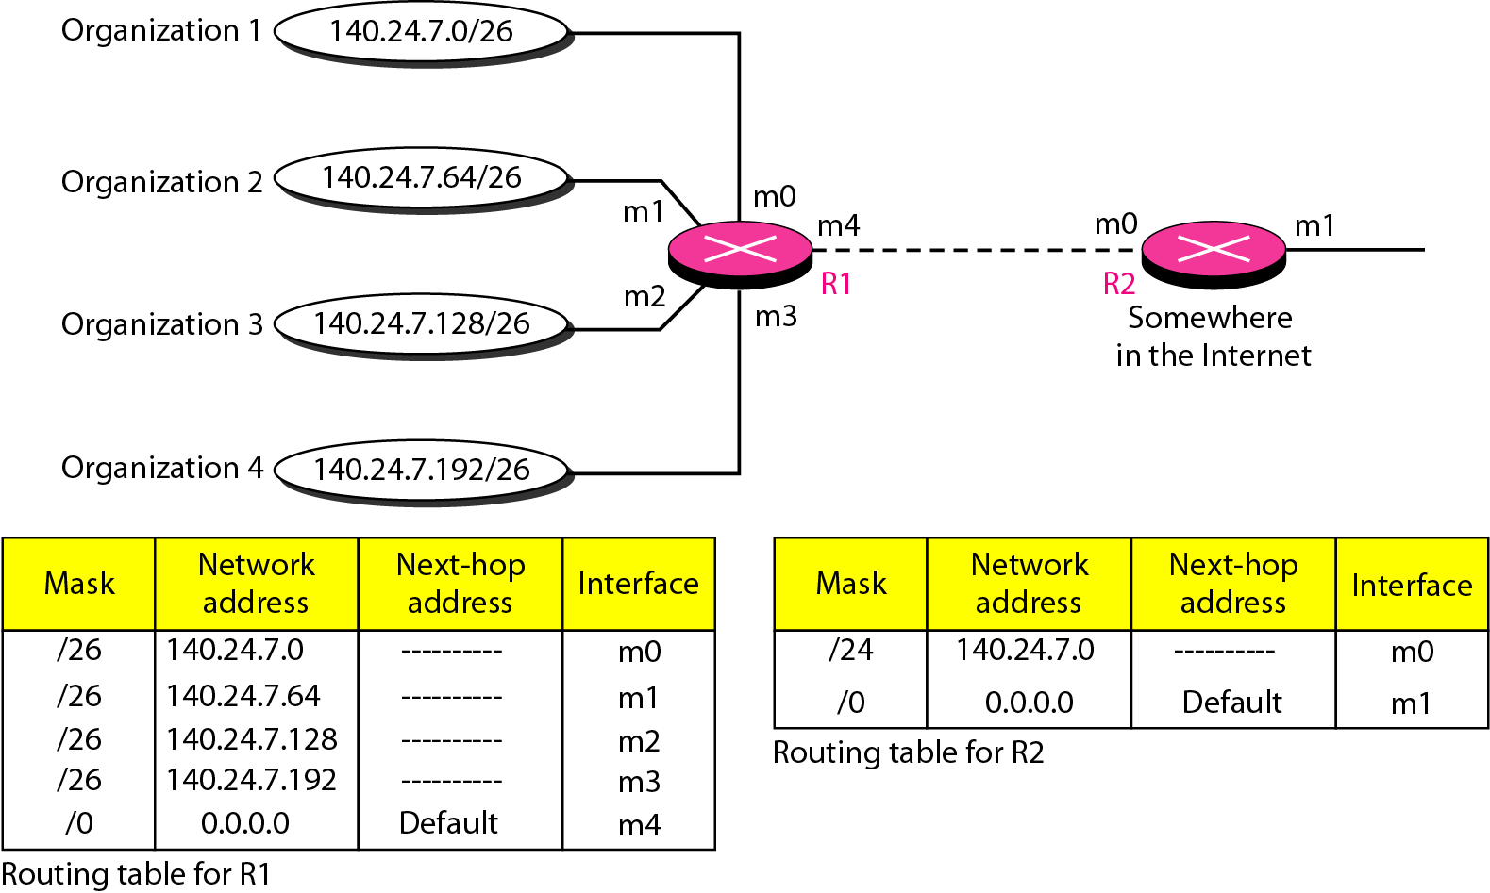
Figure 22.7 Address aggregation
22.<number>

Slide 26
Longest mask matching
What happens if one of the organization in the previous figure is not geographically close to the other three?
22.<number>

Slide 27
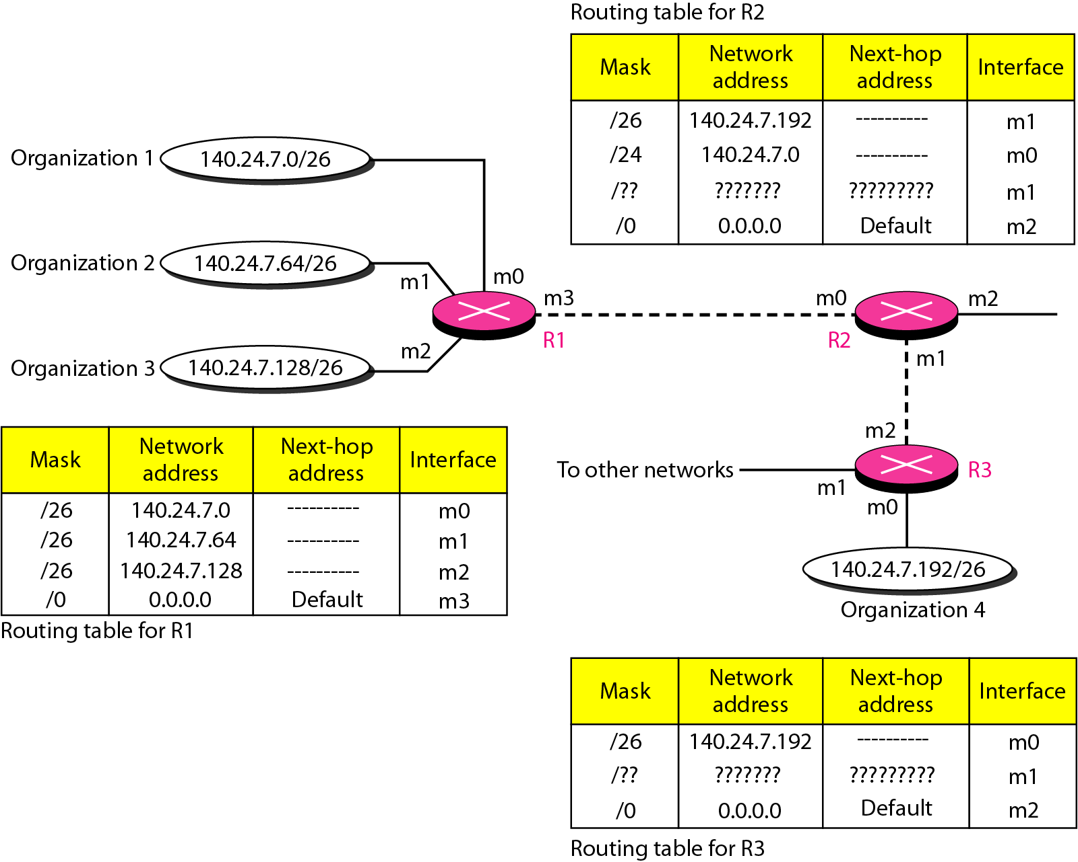
Figure 22.8 Longest mask matching
22.<number>

Slide 28
Hierarchical routing
To solve the problem of gigantic routing tables, we can create a sense of hierarchy.
22.<number>

Slide 29
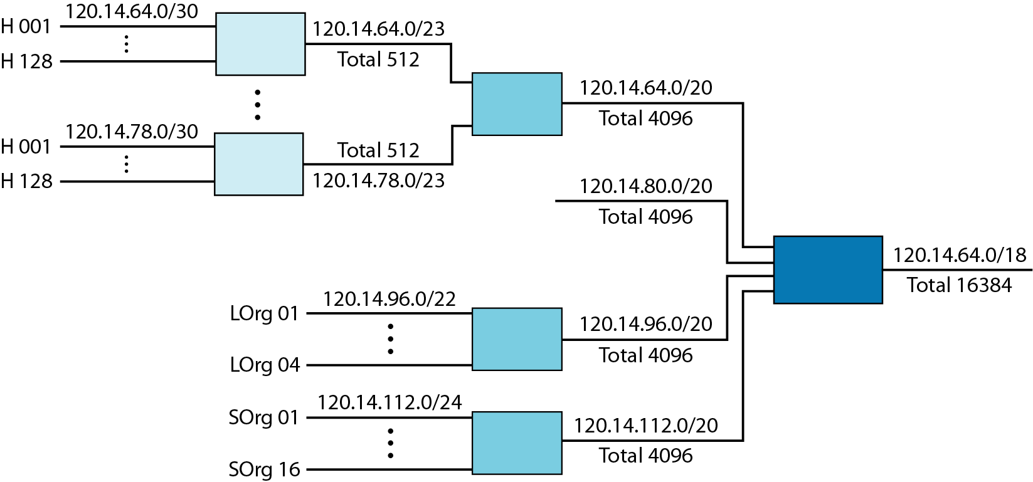
Figure 22.9 Hierarchical routing with ISPs
22.<number>

Slide 30
3- Routing Table
A host or a router has a routing table with an entry for each destination, or a combination of destinations, to route IP packets.
It can either be
  Static Routing Table
  Dynamic Routing Table
22.<number>

Slide 31
Static Routing Table
It contains information entered manually. The administrator enters the route for each destination into the table.
When table is created, it cannot update itself automatically when there is a change in internet.
It can only be used in small internet or somewhere for testing purposes.
22.<number>

Slide 32
Dynamic Routing Table
DRT updated periodically by using one of the protocols.
Whenever there is a change in internet, such as a shutdown of a router or break down a link, the dynamic routing protocols updates all the tables in the router automatically.
22.<number>

Slide 33
Format of the Routing Table
Number of columns in routing table is vender dependent.
Some common fields are:
  Mask
  Network address
  Next-hop address
  Interface
  Flags
  Reference Count
  Use
22.<number>

Slide 34
Table fields:
  Mask : mask applied for the entry.
  Network address :to which the packet is finally delivered.
  Next-hop address : next-hop router address.
  Interface: name of interface.
  Flags:
  Reference Count: number of users of this route at the moment.
  Use: number of packets transmitted through this router for the corresponding destination.
22.<number>

Slide 35
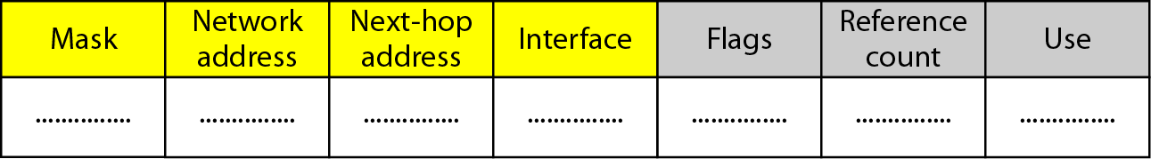
Figure 22.10 Common fields in a routing table
22.<number>

Slide 36
Flags
U (up):
  Indicates that router is up and running.
G (gateway):
  Means that destination is in another network. (indirect delivery).
H (host-specific):
  Indicates that entry in the network address field is a host-specific address.
D (added by redirection):
  Indicates that routing information for this destination has been added by ICMP.
M (modified by redirection):
  Indicates that routing information for this destination has been modified by ICMP.
22.<number>

Slide 37
Example 22.6
One utility that can be used to find the contents of a routing table for a host or router is netstat in UNIX or LINUX. The next slide shows the list of the contents of a default server. We have used two options, r and n. The option r indicates that we are interested in the routing table, and the option n indicates that we are looking for numeric addresses. Note that this is a routing table for a host, not a router. Although we discussed the routing table for a router throughout the chapter, a host also needs a routing table.
22.<number>

Slide 38
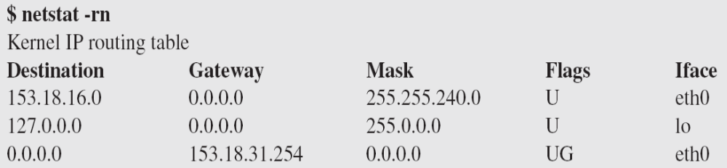
Example 22.6 (continued)
The destination column here defines the network address. The term gateway used by UNIX is synonymous with router. This column actually defines the address of the next hop. The value 0.0.0.0 shows that the delivery is direct. The last entry has a flag of G, which means that the destination can be reached through a router (default router). The Iface defines the interface.
22.<number>

Slide 39
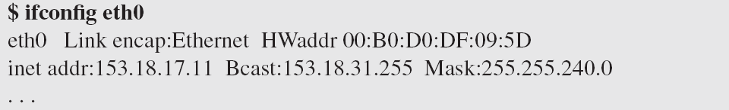
Example 22.6 (continued)
More information about the IP address and physical address of the server can be found by using the ifconfig command on the given interface (eth0).
22.<number>

Slide 40
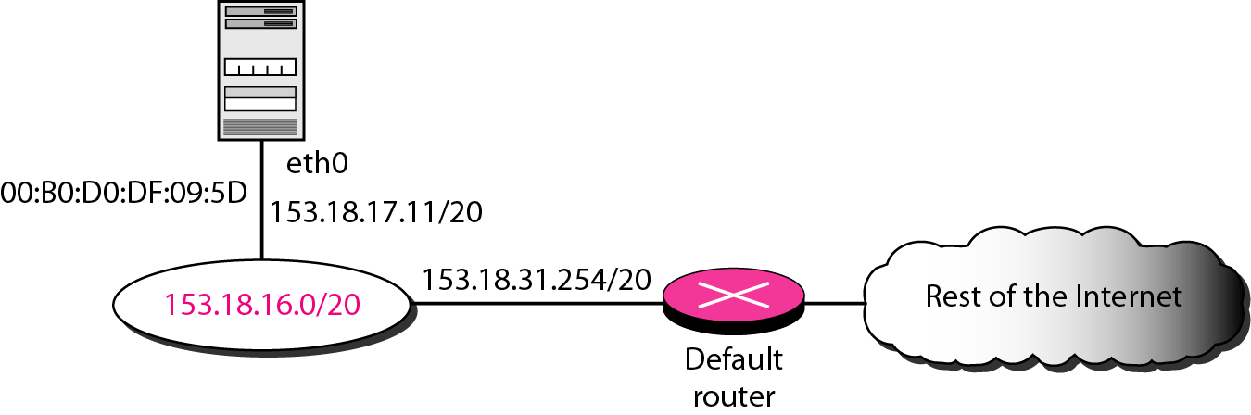
Figure 22.11 Configuration of the server for Example 22.6
22.<number>

Slide 41
22-3 UNICAST ROUTING PROTOCOLS
A routing table can be either static or dynamic. A static table is one with manual entries. A dynamic table is one that is updated automatically when there is a change somewhere in the Internet. A routing protocol is a combination of rules and procedures that lets routers in the Internet inform each other of changes.
Topics discussed in this section:
Optimization
Intra- and Interdomain Routing
Distance Vector Routing and RIP
Link State Routing and OSPF
Path Vector Routing and BGP
22.<number>

Slide 42
Optimization
A router is usually attached to several networks.
When it receives a packet, to which network should it pass the packet?
  The decision is based on Optimization: which of the available pathways is the optimum pathway?
  What is the definition of the term “optimum”.
  There are certain protocols like RIP,OSPF.. that defines the term cost, which leads to optimization
22.<number>

Slide 43
Intra and Inter Domain Routing
Today, internet can be so large that it cannot handle the task of updating the routing tables of all routers. So, internet is divided into Autonomous Systems (AS).
AS is a group of networks and routers under the authority of a single administration.
Routing inside an AS is referred to as Intradomain routing.
Routing between ASs is referred to as interdomain routing.
Each AS can choose one or more intradomain routing protocols, however, only one inter domain routing protocol handles routing between Ass.
22.o

Slide 44

Figure 22.12 Autonomous systems
22.<number>

Slide 45

Figure 22.13 Popular routing protocols
22.<number>

Slide 46

Figure 22.14 Distance vector routing tables
22.<number>

Slide 47

Figure 22.15 Initialization of tables in distance vector routing
22.<number>

Slide 48
Note
In distance vector routing, each node shares its routing table with its
immediate neighbors periodically and when there is a change.
22.<number>

Slide 49

Figure 22.16 Updating in distance vector routing
22.<number>

Slide 50

Figure 22.17 Two-node instability
22.<number>

Slide 51
Solutions for instability
Defining Infinity
  Redefine infinity to a smaller number such as 100.
Split Horizon
  Instead of flooding the table through each interface. The information needs to be come from source.
Split Horizon and Poison Reverse
  Problem in split horizon, if entry deleted then it cannot be determined either it is due to split horizon or timer expires.
  If B advertises, A stops B to advertise as A is the source.
22.<number>

Slide 52

Figure 22.19 Example of a domain using RIP
22.<number>

Slide 53

Figure 22.20 Concept of link state routing
22.<number>

Slide 54

Figure 22.21 Link state knowledge
22.<number>

Slide 55

Figure 22.22 Dijkstra algorithm
22.<number>

Slide 56

Figure 22.23 Example of formation of shortest path tree
22.<number>

Slide 57

Table 22.2 Routing table for node A
22.<number>

Slide 58
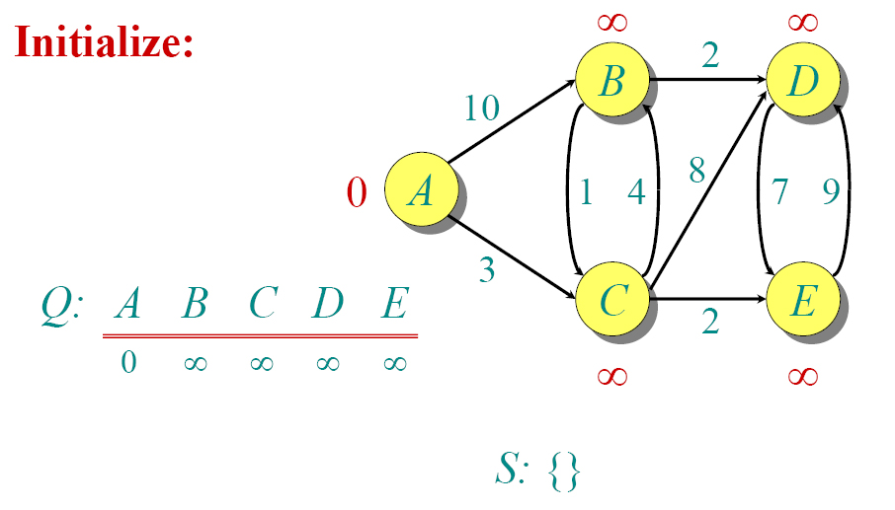
Dijkstra Animated Example

Slide 59

Dijkstra Animated Example

Slide 60

Dijkstra Animated Example

Slide 61

Dijkstra Animated Example

Slide 62

Dijkstra Animated Example

Slide 63

Dijkstra Animated Example

Slide 64

Dijkstra Animated Example

Slide 65

Dijkstra Animated Example

Slide 66

Dijkstra Animated Example

Slide 67

Dijkstra Animated Example

Slide 68

Figure 22.24 Areas in an autonomous system
22.<number>

Slide 69
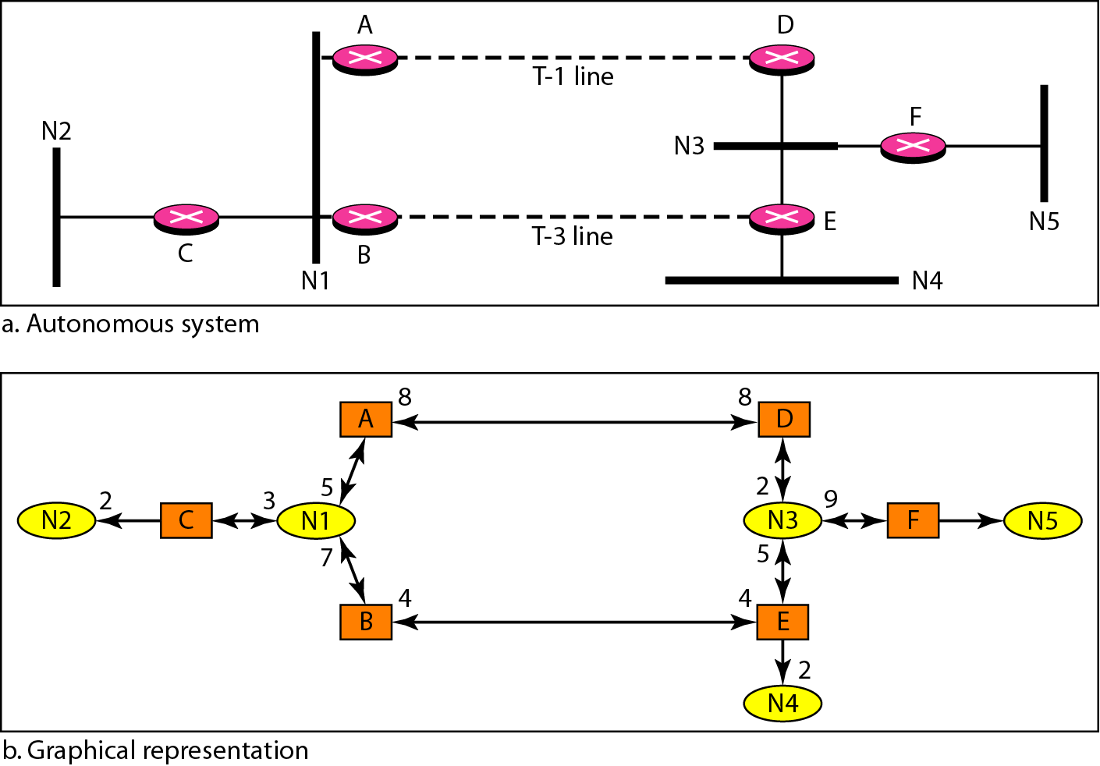
Figure 22.29 Example of an AS and its graphical representation in OSPF
22.<number>

Slide 70
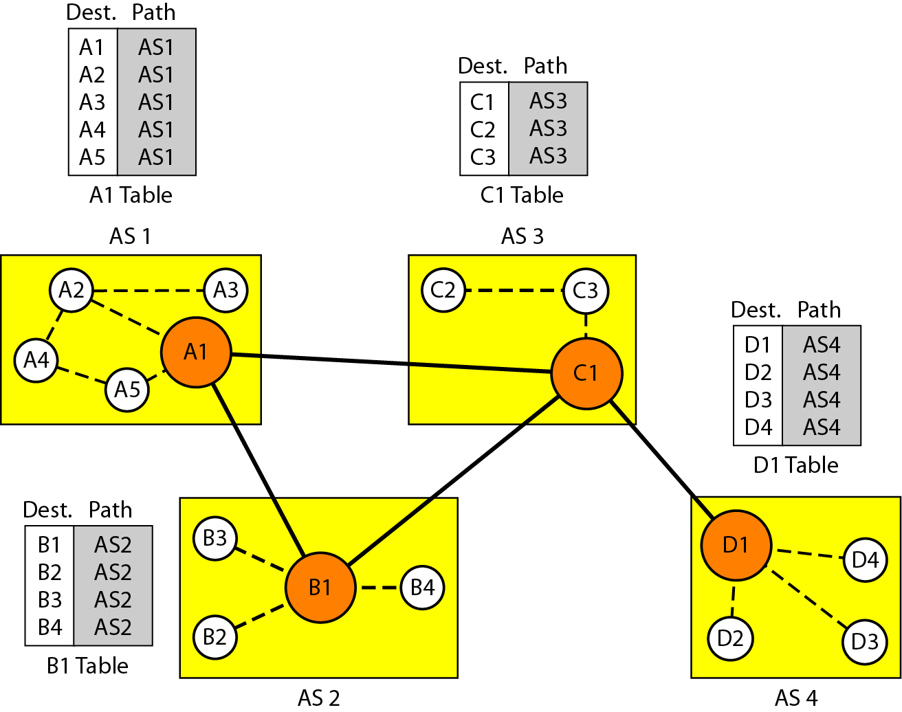
Figure 22.30 Initial routing tables in path vector routing
22.<number>

Slide 71
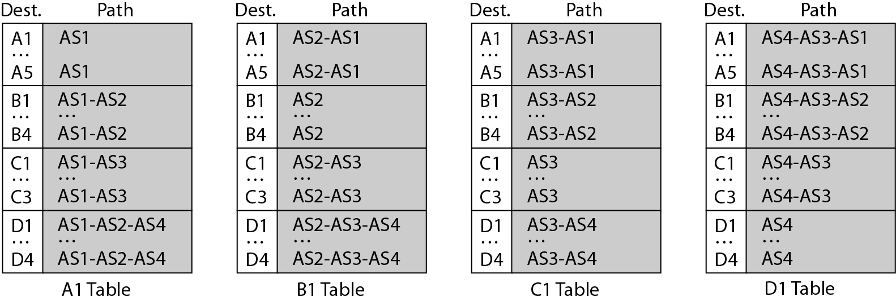
Figure 22.31 Stabilized tables for three autonomous systems
22.<number>

Slide 72
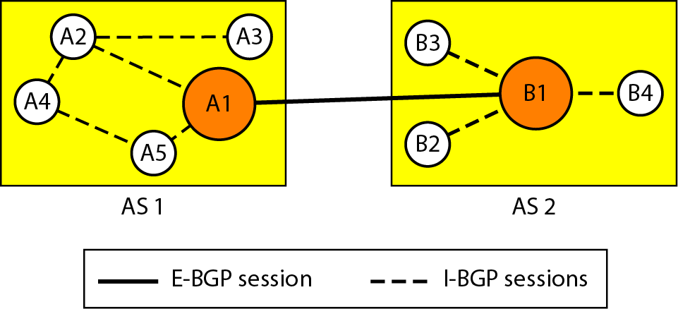
Figure 22.32 Internal and external BGP sessions
22.<number>

